Slide 1
FOOD DIARY APP
T1A3 Terminal App
Karla Bucoy
2022 OCT STND

Slide 2
AGENDA
3 Introduction
4 - 10 App walkthrough
11 - 17 Logic & code
18 - 19 Project plan & development
process
20 Reflection

Slide 3
INTRODUCTION
The purpose of the Food Diary app is to allow users to track their daily meals.
The app is targeted for users who want to form a daily habit around recording their meals, and ensuring they stay on track with their food and nutrition goals.
Users can input today's and yesterday's meals in the app and view their food diary in table format on the screen. Users also have the opportunity to edit today's and yesterday’s meals in case they have made a mistake or omitted information.
Tech Stack:
Python source code, using the PEP8 styling convention written in Visual Studio Code.
Python libraries:
Pandas for creating dataframes and reading and writing to the .csv diary file.
Datetime for calling and returning today's and yesterday's date.
Prettytable for listing additional user options and to display the diary in table format in the terminal window.
Termcolor for coloured text to highlight important messages (green - confirmations, blue - instructions, red - errors).
Markdown ReadMe file written in Visual Studio Code.
GitHub for managing source code changes and tracking and controlling versions of the source code.
Bash .sh script to execute the program.

Slide 4
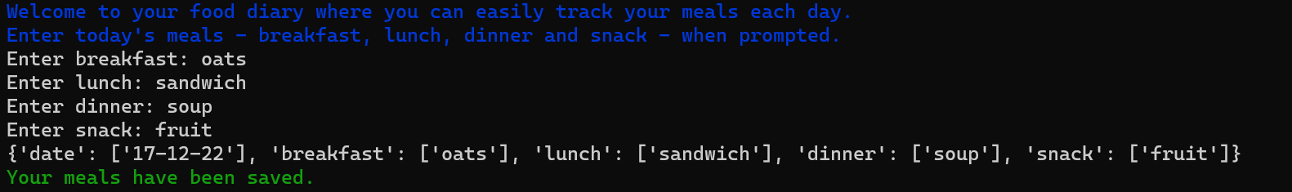
APP WALKTHROUGH: first time user
Enter today’s meals
User receives welcome message and instructions.
There is no historical data for first time users.
User is prompted to input today’s meals in order of breakfast, lunch, dinner and snack.
Users cannot enter empty meal values. If the user enters an empty value, they are prompted to enter that specific meal until the condition is met.
Meal input is saved as a dictionary and displayed on the screen, in addition to a confirmation message that today’s meals have been saved.

Slide 5
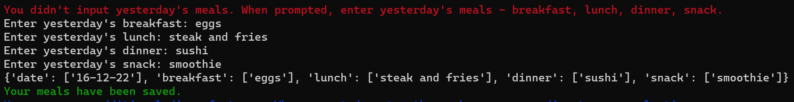
APP WALKTHROUGH: first time user
Enter yesterday’s meals
Because there is no historical data for first time users, the user is prompted to input yesterday’s meals in order of breakfast, lunch, dinner, snack.
Users cannot enter empty meal values. If the user enters an empty value, they are prompted to enter that specific meal until the condition is met.
Meal input is saved as a dictionary and displayed on the screen, in addition to a confirmation message that today’s meals have been saved.

Slide 6
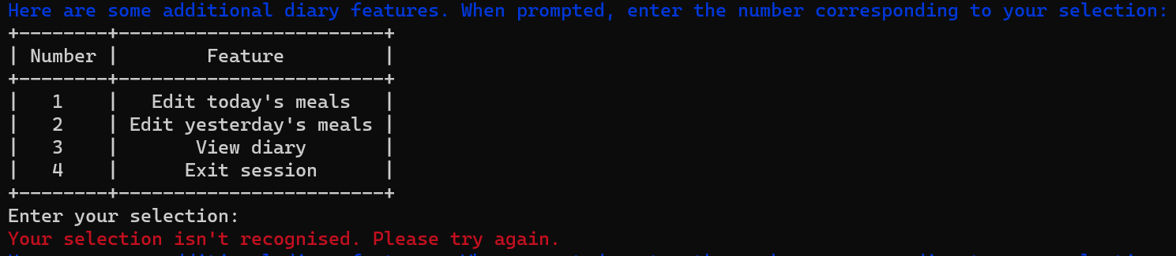
APP WALKTHROUGH: first time user
Additional features
Once today and yesterday’s meals are inputted and saved, the user is presented with additional features: edit today’s meals, edit yesterday’s meals, view diary, exit session.
Users must enter the number corresponding to their selection (per features table). If the user enters a blank value, or a value that is not one of the numbers listed in the features table, they will be prompted to enter a selection until a correct selection is entered.

Slide 7
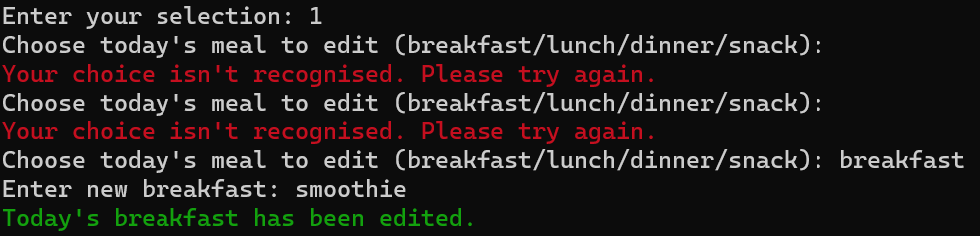
APP WALKTHROUGH: first time user
Edit today’s meals
If editing today’s meals, users are prompted to enter the meal of their choice to edit.
Users must enter the name of the meal as it appears in the prompt. If the user enters a blank value, or a value that doesn’t match the meal name, they will be prompted to enter a selection until a correct selection is entered.
Once today’s meals is edited the user will receive a confirmation message, and then they will return to the additional features menu for further editing or viewing of the diary or exiting the program.

Slide 8
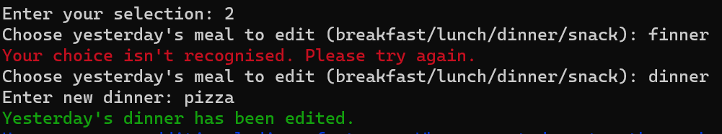
APP WALKTHROUGH: first time user
Edit yesterday’s meals
If editing yesterday’s meals, users are prompted to enter the meal of their choice to edit.
Users must enter the name of the meal as it appears in the prompt. If the user enters a blank value, or a value that doesn’t match the meal name, they will be prompted to enter a selection until a correct selection is entered.
Once yesterday’s meal is edited the user will receive a confirmation message, and then they will return to the additional features menu for further editing or viewing of the diary or exiting the program.

Slide 9
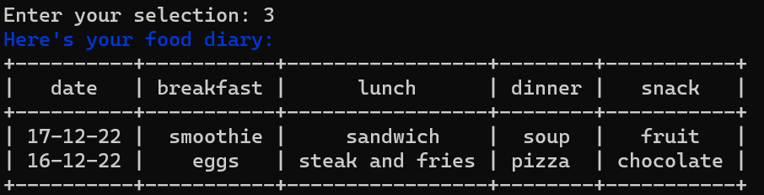
APP WALKTHROUGH: first time user
View diary
Upon selecting ‘View diary’ the user’s food diary is displayed in table format on the screen.
Underneath the diary table, the additional features menu and prompt is displayed allowing the user to select options for further editing or viewing of the diary or exiting the program.

Slide 10
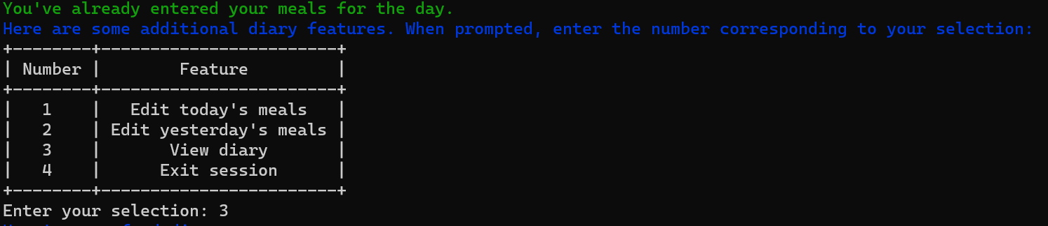
APP WALKTHROUGH: returning user
Additional features
Returning users who have entered today’s and yesterday’s meals receive a confirmation message and are presented with the additional features menu.
Users are then able to edit today’s meals, edit yesterday’s meals, view their diary or exit the program.
The additional features menu experience is the same as the first time user additional features menu experience and utilises the same code base.

Slide 11
LOGIC & CODE
Habit formation
The app is designed to help users form a daily habit around recording meals.
Users can:
Input and edit today’s meals.
Input and edit yesterday’s meals.
View their food diary.
Because users are unlikely to remember what they ate a week ago, let alone several days ago, inputs and edits are limited to two days: today and yesterday. It was unnecessary to include a function for entering and editing historic data past yesterday’s date.

Slide 12
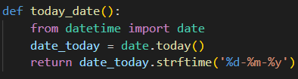
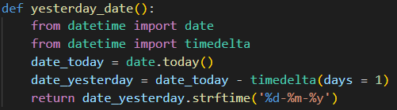
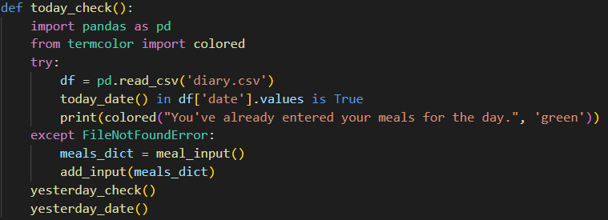
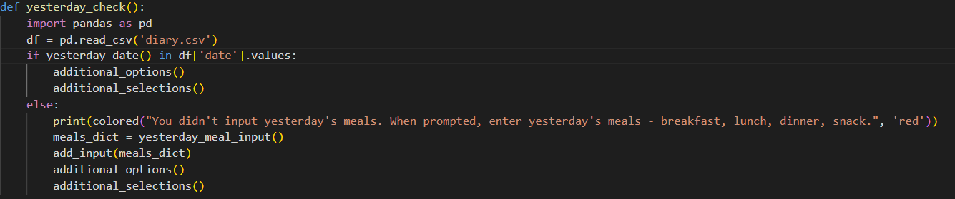
LOGIC & CODE
Date checks
Functions to call and return today’s and yesterday’s date were written using the datetime module to:
Check whether today’s and yesterday’s meals have been inputted. If meals have been inputted, users receive a confirmation message. If meals haven’t been inputted, users will be prompted to input their meals. For a first time user without any historical meal data, the app will create a diary.csv file and write meal input to it.
Edit today’s and yesterday’s meals by locating the specific date in the diary.csv file and overwriting existing meal data in that date’s row.

Slide 13
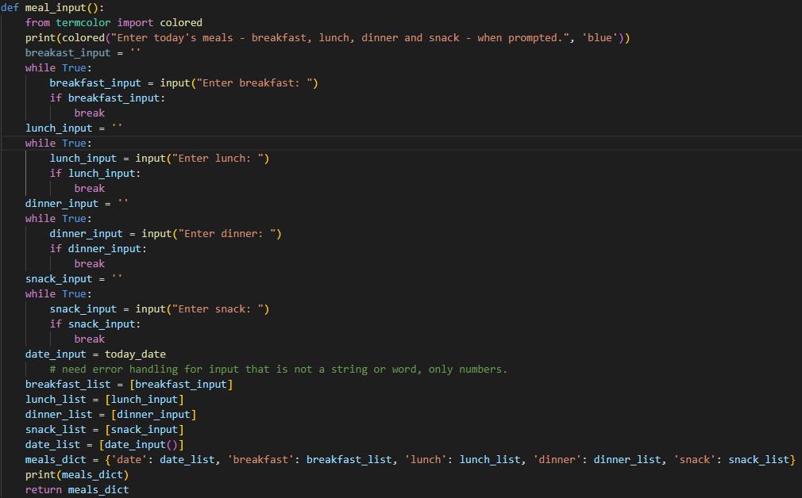
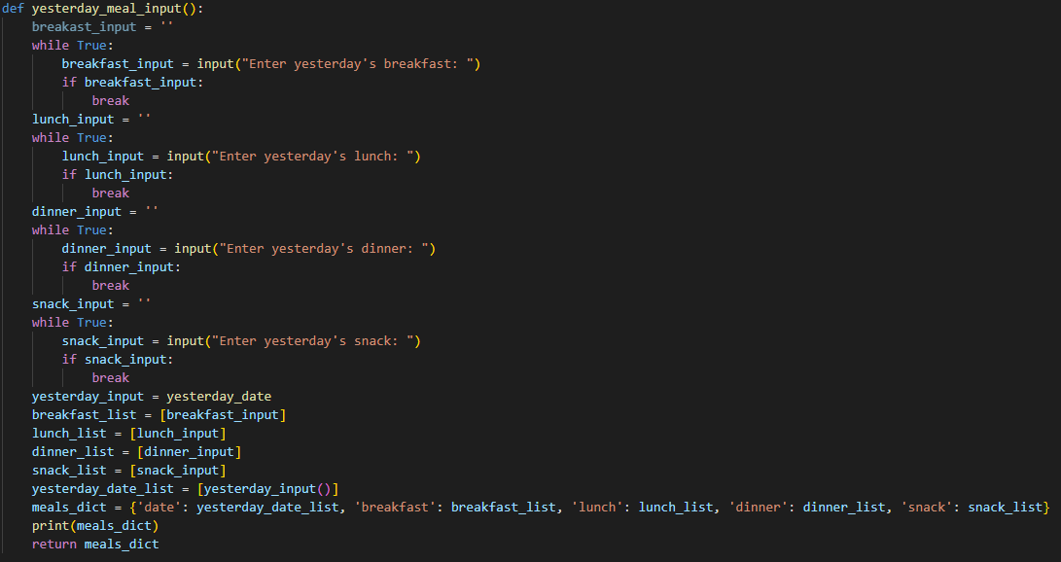
LOGIC & CODE
Inputting meals
Functions to input and return today’s and yesterday’s meals were written to:
Prompt users to input their meals in order of: breakfast, lunch, dinner, snack.
Users cannot input empty meal values. If the user enters an empty value, a while loop is activated prompting the user to enter that specific meal until the condition is met.
Meal inputs and the corresponding date are then saved in a dictionary and printed on the screen.

Slide 14
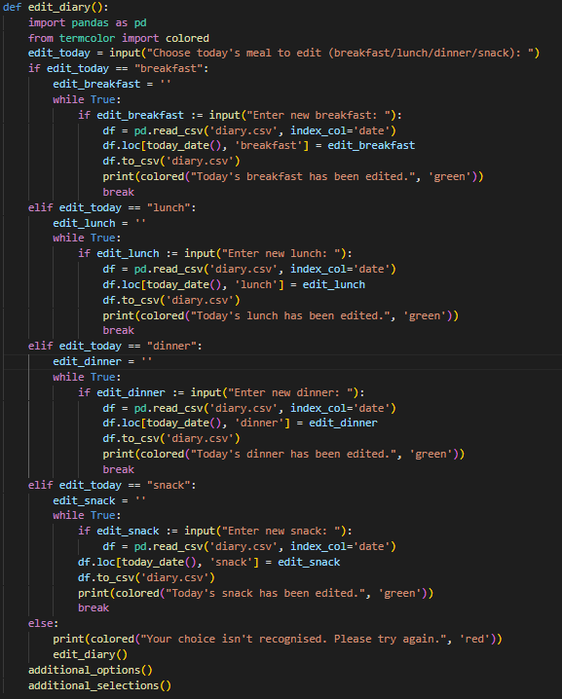
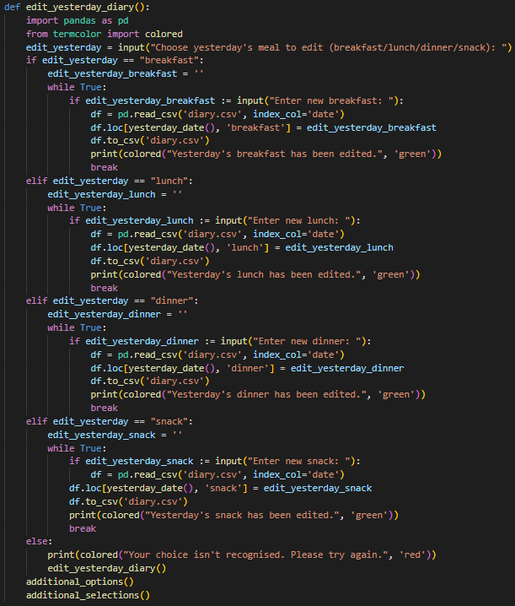
LOGIC & CODE
Editing meals
Functions to edit today’s and yesterday’s meals and return the edits were written to:
Prompt users to edit yesterday’s and today’s meal inputs.
Users must enter the name of the meal as it appears in the prompt. If the user enters a blank value, or a value that doesn’t match the meal name, a while loop is activated prompting the user to enter that specific meal until the condition is met.
Edited meal inputs and the corresponding date are then saved in a dictionary and printed on the screen.

Slide 15
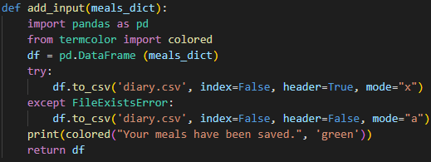
LOGIC & CODE
Saving meals to .CSV file
A function to save meal data was written using Pandas:
Convert the meals dictionary created from the meal input and edit functions into a Pandas dataframe and save the dataframe as a .csv file (‘diary.csv’) for easy access and editing.
The function first checks if a ‘diary.csv’ file already exists, and handles a FileExistsError using a try except statement:
If the file doesn’t exist, the function creates the file and saves the meal data to the file.
If the file exists, the function saves the meal data to the file.
Users then receive a confirmation that the meals have been saved to the diary.

Slide 16
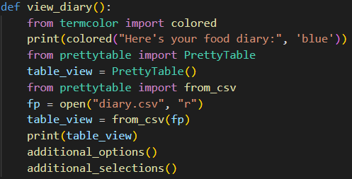
LOGIC & CODE
Displaying the diary
A function to display the food diary using PrettyTable was created to convert diary.csv data into an ASCII table to be displayed on the terminal screen.

Slide 17
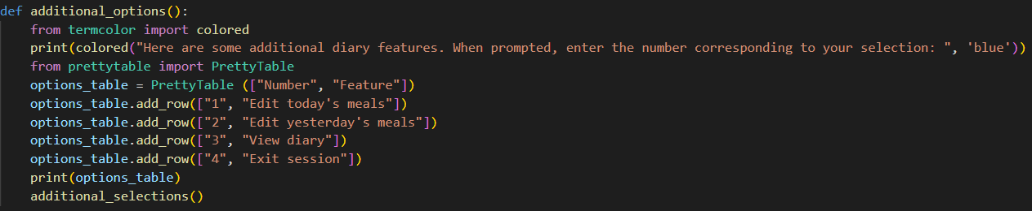
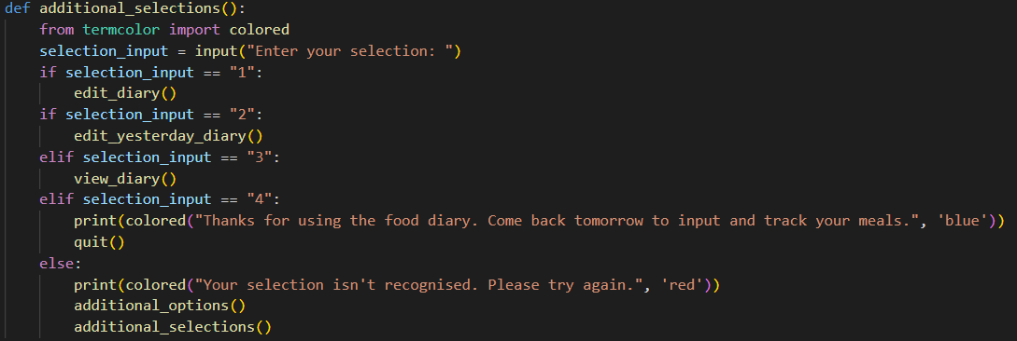
LOGIC & CODE
Additional app features
Functions to display and activate additional app features (edit today’s meals, edit yesterday’s meals, view diary, exit) were created to:
Display and prompt users to select additional app features in an easy to read table using PrettyTable.
Users must enter the number corresponding to their selection (per features table). An if-elif-else statement handles the scenario if the user enters a blank value, or a value that is not one of the numbers listed in the features table, advising them the input is not recognised, and to try again until a correct selection is entered.
Additional app features are called after meals are inputted or edited, or the diary is viewed.

Slide 18
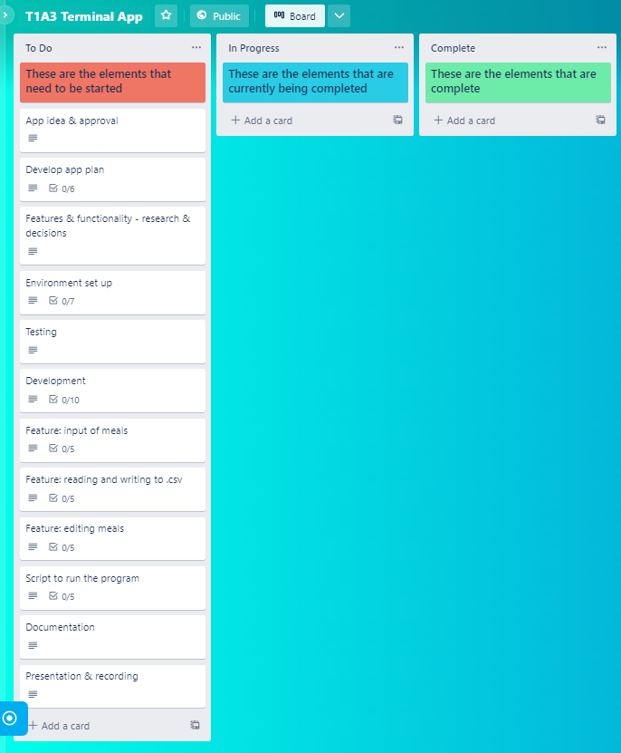
PROJECT PLAN
The project plan was tracked using Trello.
View the board here: https://trello.com/b/TwGduS2x/t1a3-terminal-app.
The project was broken down into 5 stages:
Stage 1: Initial Planning where a full outline of the tasks and subtasks required to complete the project were listed in Trello in order of what was to be actioned and completed first. This ensured no steps were missed and provided a useful guideline for the order of operations.
Stage 2: Planning Progress including the initial approval of the app idea by CA educators and the development of a full app plan including target users and app features. Then, decisions on key app features and functionality were made, and the research of Python packages and useful functions commenced.

Slide 19
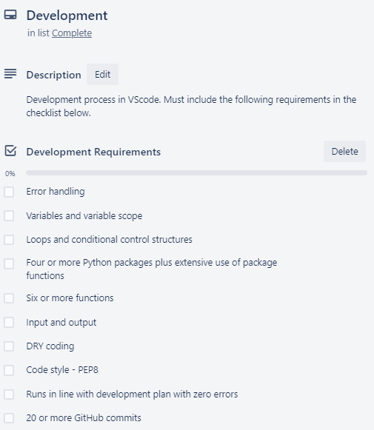
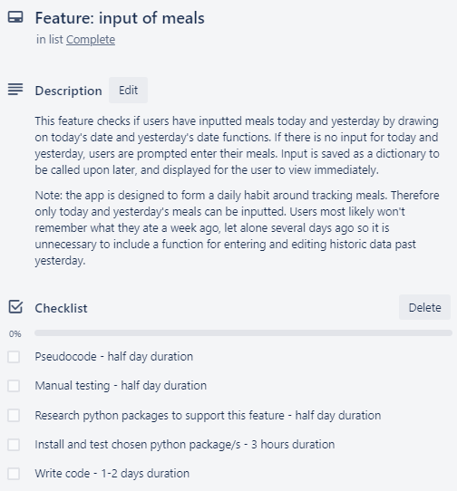
PROJECT PLAN
Stage 3: Testing & Development where manual tests were conducted on two key features (inputting meals and saving to .csv) and then developed in Visual Studio Code. The manual tests were both unit tests which were designed to test several scenarios to ensure the functions worked as intended, and enhanced the overall user experience.
A development plan board containing a checklist of all the requirements of the assignment helped to guide the features and functionality of the app, as well as other important best practices (e.g. PEP8 style convention, regular GitHub commits).
Key feature plan boards were also created as these features are critical to the app running as expected, without errors. Again, a checklist was used including approximate durations to guide the development process.
Stage 4: Scripting & Documentation where a bash script was written to facilitate execution of the program. In addition, documentation (README.md) was written containing all information necessary for users to run the program plus additional helpful information about the program and its functions and features.
Stage 5: Completion & Submission where I packaged up all files and documentation into a .zip file as per the assessment requirements, and submitted via Canvas.

Slide 20
REFLECTION
Much like the portfolio website this project was particularly challenging as I’ve never coded in Python before, let alone developed a fully functioning app.
The most difficult parts of the project were creating logical code structures and functions that were Pythonic and DRY. There are so many ways to write Python code that works, but it was ensuring that code was efficient and handled errors that took up the majority of project time.
One of the most enjoyable parts of the project was creating the project plan and documentation. I enjoy the planning stages of projects and the documentation allowed me to reflect on what I had created, and even helped to identify some missing pieces and rectify this.
This app is very simple, and I would like to further develop additional features to make it more valuable and user-friendly.

